Slide 1
AWS tech intro
How will we be using it?
How does it work?

Slide 2
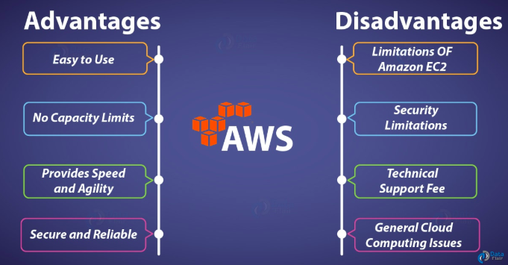

Slide 3
What services are we interested in?
Virtual servers - EC2
Cloud storage - S3
Database service - RDS (as interfaced with PostgreSQL)
Potentially interesting - Lambda (serverless)

Slide 4
What’s EC2?
Elastic Compute Cloud, for our purposes the same as any server, but scalable, cheap if we need it to be, and really elastic. We control how much or how little processing power, memory, cores, etc.. Control can be very granular and restrictive, or very fluid.
We will put our server code on here (Python, Django), which will allows us to make POST, PUT, GET, DELETE requests to our RDS database, and allow us to pull files from our S3 buckets. Uploading server code is simple, and like any traditional server really.

Slide 5
What’s S3?
Simple Storage Service (S3) is a straightforward file storage cloud.
Essentially like any cloud you’re used to using - MEGA, Google Drive, Apple Cloud.
Except: files you store are indexable, and callable by other AWS services.
We will be using S3 to store photos of apples, of trees, and large chunks of other data if necessary. These photos and data will then be called and indexed through our PostgreSQL-RDS database.

Slide 6
What’s RDS?
This one I haven’t used before btw.
Relational Database Service (RDS) Allows you to set up a PostgreSQL database in the cloud.
Calls will be made to the RDS database by EC2.
Our RDS database will index files from S3.

Slide 7
We didn’t plan on using Lambda, and we definitely don’t need to. Let’s keep it in mind though!
Serverless - allows you to run code without paying attention to server-time, server-downtime, etc.
Could be good for specialized and occasional purposes: uploading images to S3, Downloading entire database, etc.

